Slide 1



USE to EDUCATE

Slide 2

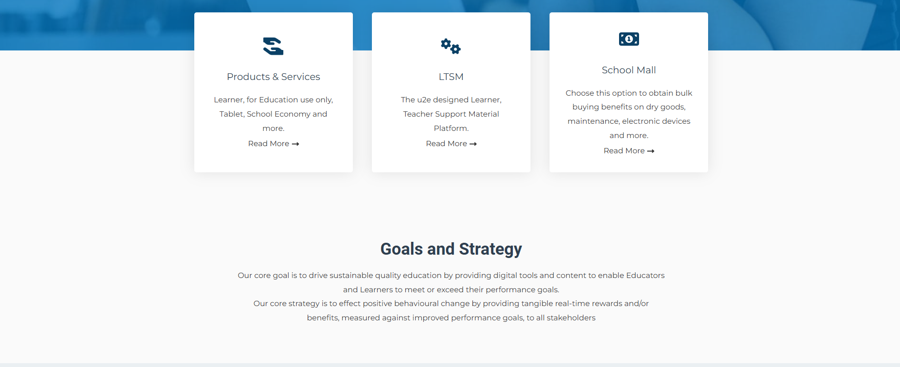
WHEN YOU CLICK
IT SHOULD DIRECT YOU TO THIS PAGE

Slide 3

WHEN YOU CLICK
IT SHOULD DIRECT YOU TO THIS PAGE

Slide 4

WHEN YOU CLICK
IT SHOULD DIRECT YOU TO THIS PAGE

Slide 5

LOGIN REGISTER
Elevate Your Coaching Skills with the SAFA & U2E D License Coaching Course!
Join the South African Football Association (SAFA) and U2E in empowering the next generation of football players. Become a certified coach and help young players develop skills while having fun!
Enroll Now
Learn More
About the D License Coaching Course
Course Overview: "The SAFA & U2E D License Coaching Course is a comprehensive program designed to train coaches who will inspire and develop young football players aged 6-12. Whether you're new to coaching or looking to expand your knowledge, this course provides all the essential tools to help you guide kids in a safe, engaging, and fun environment."
Course Duration: 80 hours (split across two phases, 5 days in-person training + 6 weeks of distance learning)
Target Audience: Aspiring football coaches, teachers, and community leaders.
Certification: Successful completion of the course awards a recognized SAFA D License, enabling coaches to work with youth players at grassroots levels.

